Slide 1
Introduction to artificial intelligence, machine learning, and deep learning
High-level definitions of fundamental concepts
Timeline of the development of machine learning (ML)
Deep learning’s (dl) rising popularity and future potential

Slide 2
What is deep learning?
What is Artificial Intelligence, Machine Learning, and Deep Learning?
How do they relate to each other?
Deep Learning (DL) is a sub-domain of Machine Learning (ML), and Machine Learning is a sub-domain of Artificial Intelligence (AI)

Slide 3
What is artificial intelligence?
AI was born in the 1950s
AI Pioneers started asking whether computers could be made to “think”
AI crystallized as a field of research in 1956 from a summer workshop conducted by John McCarthy, Assistant Professor of Mathematics, Dartmouth College
Definition:
AI can be defined or described as the effort to automate intellectual tasks normally performed by humans
AI can be defined as getting computers to make decisions that look smart
Artificial Intelligence
Hardcoded Rules – Early Chess Programs
Symbolic AI (1950s – 1980s)
Human-Level AI: Large sets of Explicit Rules manipulating knowledge stored in explicit databases
Expert Systems (1980)
Dominant Paradigm of Symbolic AI in 1980s
Solve well-defined, logical problems
Chess Programs, Medical Applications
Symbolic AI and Expert Systems: Intractable to define explicit rules for Complex and Fuzzy problems
Image Classification
Speech Recognition
Natural Language Translation

Slide 4
What is machine learning (ML)?
Rules
Classical Programming
Answers
ML was also born in the 1950s
ML started to flourish in the 1990s
Currently, ML is the most popular and most successful subfield of AI
Definition:
ML is defined as the idea of learning from previous experiences
ML is programming computers to optimize a performance criterion using example data or experience
ML computer programs are expected to improve performance as more and more examples are available
Sufficient examples should enable learning of patterns and produce intelligent outputs for new inputs
At the core of classical computer programming is the algorithm
An algorithm is a sequence of instructions that transform inputs into outputs
Classical computer programs assume a deterministic output for each input
Data
Data
Machine Learning
Rules
Answers

Slide 5
What is machine learning? - continued
Machine Learning, though related to Mathematical Statistics, differs from Statistics in several important ways:
ML tends to deal with large, complex datasets for which classical statistical analysis, such as Bayesian analysis would be impractical
Examples of Large Complex Datasets – Imagenet, MNIST, Fashion MNIST, etc
ML exhibits comparatively little mathematical theory – maybe too little
Black box approach
Unlike theoretical physics or mathematics, ML is a very hands-on field
Driven by empirical findings
ML is fundamentally an Engineering Discipline
Reliant on advances in software and hardware

Slide 6
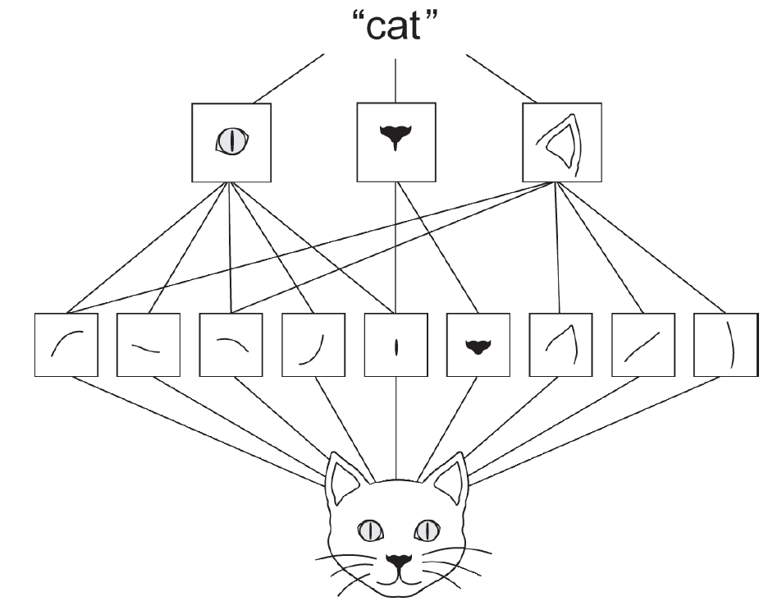
What is deep learning?
Deep Learning (DL) is a specific subfield of ML with a new take on learning representations from input data:
Emphasis on learning successive layers of increasingly meaningful representations
The "Deep" in DL is not referring to any kind of deeper understanding of the input data by the model
"Deep" refers to the idea of successive layers of representations
Deep models have more depth (layers) than shallow models
Modern DL often involves tens or even hundreds of successive layers of representations. Each learned automatically from exposure to input or training data
Visual word forming a spatial hierarchy of visual modules
(Ref: Deep Learning with Python, 2nd Edition, Francois Chollet)

Slide 7
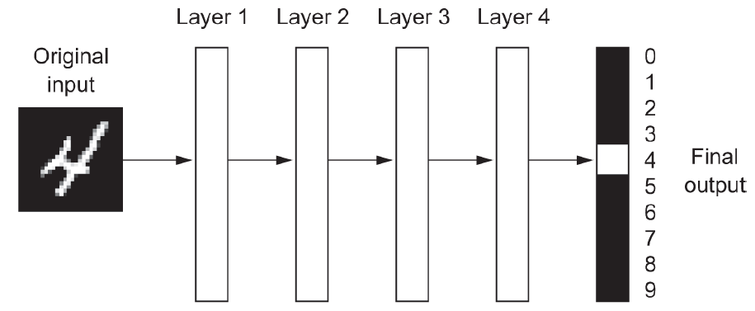
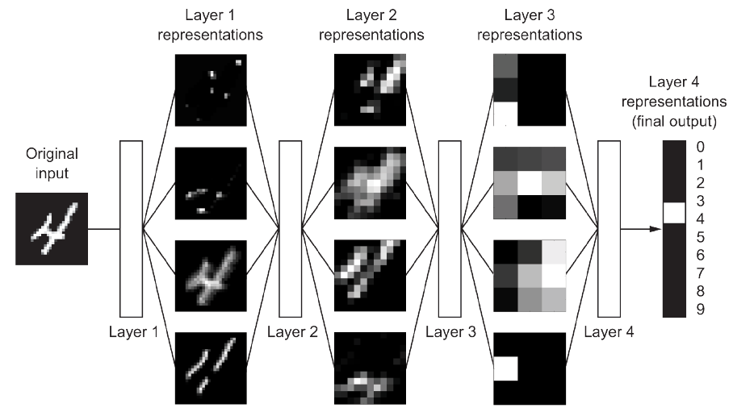
What is deep learning - continued?
A Deep Learning Neural Network for Digit Classification
Deep representations learned by the digit-classification Model
(Ref: Francois Chollet)
(Ref: Francois Chollet)

Slide 8
Evolution of artificial intelligence?
Artificial Intelligence – 1950s
Machine Learning – 1990s
Deep Learning– 2012

Slide 9
Evolution of machine learning to current form – deep learning
Probabilistic Modeling, 1950s
Statistics to Data Analysis: Naïve Bayes Algorithm
Early Neural Networks,
1980 - 1995s
Backpropagation Algorithm: LeNet used by USPS to read zip codes, 1990
Kernel Methods,
1990 - 2000s
Classification Algorithm: Support Vector Machines (SVMs)
Decision trees, Random forests and Gradient boosting Machines
2000s – 2010s
Prediction Models: Flowchart-like Structures
Deep Convolution Neural Networks (CNNs), Recurrent Neural Networks (RNNs), Generative Adversarial Networks (GANs), Encoder – Decoders, Transformers, etc.
Back to Neural Networks and Deep Learning
2012

Slide 10
What are machine and Deep learning algorithms or what is learning in machine and Deep learning?
A ML or DL Model transforms its input data into meaningful outputs
Transforming input data into meaningful outputs is a process that is learned from exposure to known examples of inputs and outputs
The core or central problem in ML and DL is to meaningfully transform data i.e., learn useful representations of the input data at hand and get closer to the expected output
Learning requires:
Input data points and corresponding Expected Outputs:
Speech Recognition: Sound files of people speaking and corresponding human-generated transcripts of sound files
Image Tagging or Classification: Pictures with distinct objects and corresponding tags (Cats vs Dogs)
Measurement of the Algorithm Performance
Distance between the Algorithm’s current output and its expected output
The distance is the feedback signal used to adjust the working of the algorithm
Learning is the process of adjusting the working of the Algorithm to reduce the distance between the current output and its expected output

Slide 11
Deep learning process
Machine and Deep Learning is about mapping inputs (such as images) to targets (such as labels “Cats” or “Dogs”)
Learning is accomplished by observing many examples of inputs (Images of “Cats” and “Dogs”) and targets (Labels: Cats or Dogs)
Deep Learning Models known as Deep Neural Networks perform input-to-target mappings via a deep sequence of simple data transformations (layers).
Deep Learning Process:
A Layer's transformation dictates how the input data is passed through the Layer's weights
The transformation implemented by a layer is parameterized by the weights of the layer
The weights of a layer are called the parameters of a layer
In this context, Learning is finding a set of values for the weights in all layers of a Deep Neural Network such that the network will correctly map example inputs to their associated targets

Slide 12

Neural networks – parameterized by its weights
Input X
Deep Neural Networks can contain tens of millions of parameters or weights
Determining the correct value for all the weights can be a daunting task since modifying the values of one weight will affect the behavior of all other weights.
Weights are modified by measuring how far the output is from what you expected.
Weights
Layer
(Data transformation)
Goal: Finding
The right values
for these weights
Weights
Layer
(Data transformation)
Predictions
$$Y^{′}$$

Slide 13


Loss score – distance between actual and expected outputs
The loss function of the Network measures the difference between the calculated output (from a given input) and an expected output
The loss function is also called the objective function or cost function
The loss function takes the predictions of the network and the true targets and computes a distance or Loss score
The distance or Loss score describes how well the network has done on this specific input
Input X
Layer
(Data transformation)
Weights
Layer
(Data transformation)
Weights
Predictions
$$Y^{′}$$
True Targets
$$Y$$
Loss
Function
Loss
Score

Slide 14
Weight adjustments to minimize the loss score
The fundamental concept of Deep Learning is to use the Loss Score as a feedback signal to adjust the values of the weights
The weight adjustment is the job of the Optimizer, which implements the Backpropagation Algorithm, the central algorithm in Deep Learning
The direction in which the weights are adjusted will lower the Loss Score for the current example input
Input X
Layer
(Data transformation)
Weights
Weights
Layer
(Data transformation)
Predictions
$$Y^{′}$$
True Targets
$$Y$$
Loss
Function
Optimizer
Loss
Score

Slide 15
DEEP LEARNING process - continued
Initially, the weights of the Deep Neural Network are assigned random values
Initially, the network merely implements a series of random transformations resulting in:
The calculated output being far from the expected output
A very high value of the Loss Score
With each example input presented to the network:
The weights are adjusted a little in the correct direction
The Loss Score decreases
This is known as the Training loop or Training phase.
An iteration of the Training Loop is known as an epoch
Running through the Training Loop yields weight values that minimize the Loss Function. Typically, there are tens of epochs to cover thousands of input examples.
A Deep Neural Network with a minimal loss score is known as a trained network. This suggests that the calculated outputs are as close as they can be to the expected targets
A trained network is expected to produce accurate outputs for example inputs that were not used during the training phase

Slide 16
Why deep learning? Why now?
Backpropagation Algorithm for Neural Networks and Convolution Neural Networks for Computer Vision were well-known and researched in the 1990s.
Other important algorithms, like the Long Short-Term Memory (LSTM) algorithm fundamental for deep learning time-series (Stock Market prediction) was developed in 1997 and have not changed.
The three technical forces driving the advancement of Machine Learning in particular Deep Learning are
Computer Hardware – Development of Massively Parallel Chips – Graphical Processing Units (GPUs)
Datasets and Benchmarks – Data is the coal for the Deep Learning Steam Engine of the ML revolution
ImageNet – 1.4 million images with hand annotated 1,000 image categories
The advent of several simple important algorithmic improvements to address drawbacks of gradient optimization

Slide 17
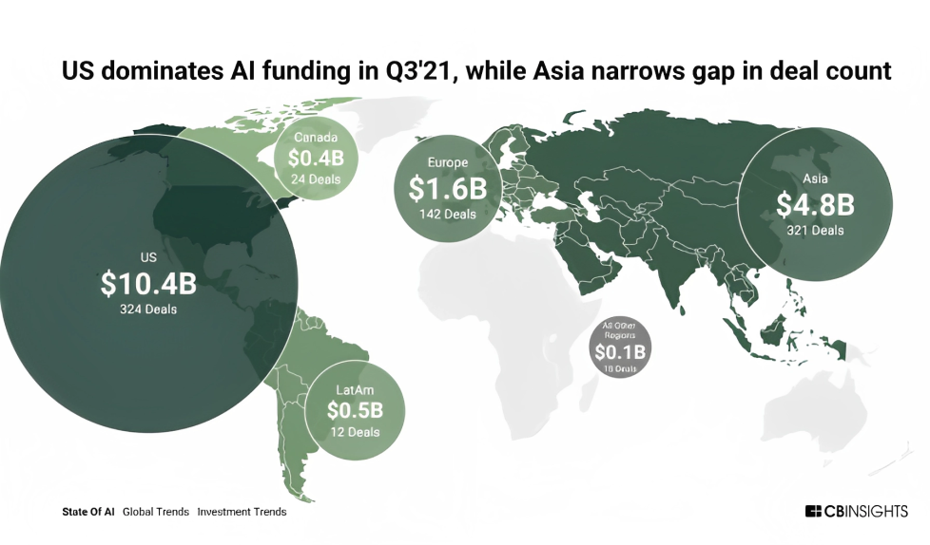
AI Deals & Funding
CBINSIGHTS – State of AI

Slide 18
Current deep learning achievements
List of breakthroughs due to Deep Learning – All in historically difficult areas of Machine Learning
Near-human-level image classification
Near-human-level speech transcription
Near-human-level handwriting transcription
Dramatically improved machine translation
Dramatically improved text-to-speech conversion
Digital assistants such as Google Assistant and Amazon Alexa
Near-human-level autonomous driving
Improved ad targeting, as used by Google, Baidu, or Bing
Improved search results on the web
Ability to answer natural-language questions
Superhuman Go playing

Slide 19
Short-term hype
Believable Dialogue Systems
Human-level Machine Translation across arbitrary languages
Human-level natural-language understanding
Artificial General Intelligence (AGI)
The above applications will be elusive for a long time as they are SHORT-TERM HYPE
First AI winter– 1970s
Second AI winter – 1990s (Symbolic AI - Expert Systems, and Earlier Neural Networks)
Currently – a third cycle of AI hype and disappointment
The long-term vision for AI is promising

Slide 20
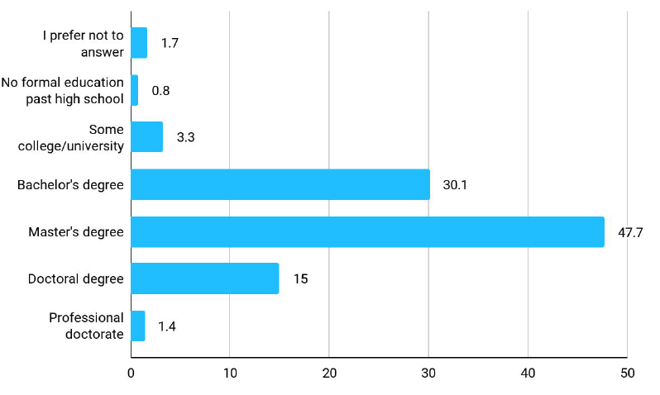
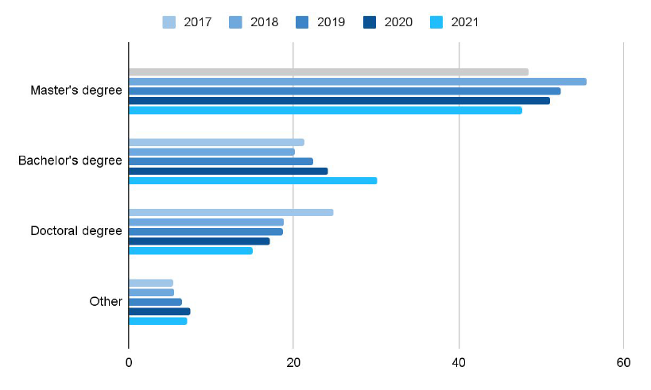
Education level of ml/data scientists
Tool usage across the machine learning and data science industry
(source:www.kaggle.com/kaggle-survey-2021)

Slide 21
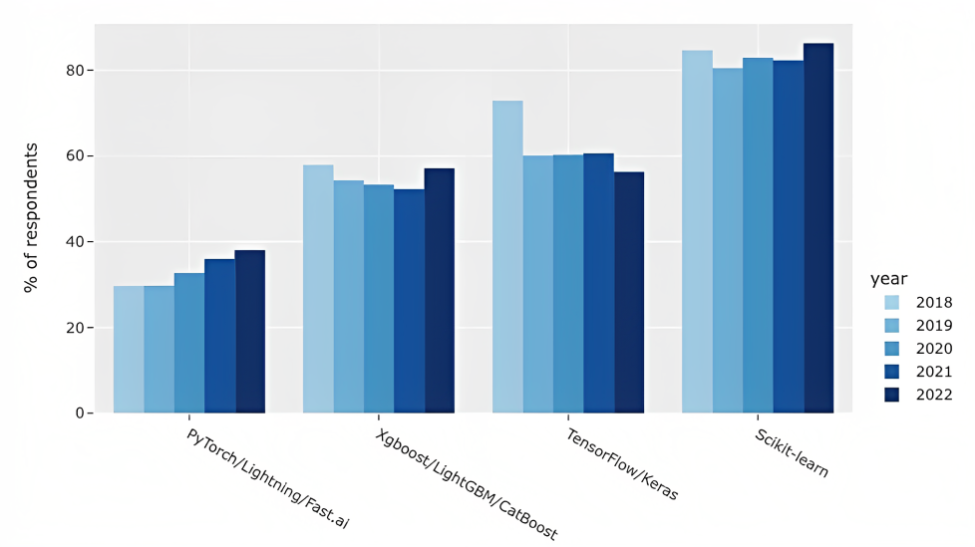
Modern machine learning tools used by industry
Tool usage across the machine learning and data science industry
(source:www.kaggle.com/kaggle-survey-2022)

Slide 22

Up Next
Introduction to artificial neural networks
Input X
Weights
Layer
(Data transformation)
Goal: Finding
The right values
for these weights
Weights
Layer
(Data transformation)
Predictions
$$Y^{′}$$

